Slide 1
MEDICAL e card
Submitted by:-
RINI AMADO

Slide 2
INTRODUCTION
Health card is a web based portal developed using PHP as Front end and MySQL as backend.
This portals controlled by Health department and provide Health Card to all citizen of the selected area. Area is created by the administrator.
Health card is a card which contains the information about health details of an individual. This card is issued by government.
It contains the medical reports, treatment details, prescriptions and the health status of that individual. It also contains the details about the family members and their contact numbers.

Slide 3
All information from the card is accessed using a barcode reader which attached in the hospital.
All the treatment details like x-ray report scan report, ECG, lab- blood reports all can be attached and display through the portal. If in case of an emergency if the individual is alone this card can be used to access the health conditions and the information about their near ones.
This project is developed using responsive template and all technologies like HTML, JavaScript, JQuery, AJAX CSS are loaded

Slide 4
THE NEED
A Fully Digital Card and zero documentation needed.
All health related information under your fingertips.
Enables doctors to learn complete health status of an individual.
With the help of a health card people can avail all the necessary health related benefits from the government according to the criteria.
Medical reports ,lab reports ,prescriptions etc is just one click ahead.

Slide 5
SYSTEM DESIGN
MODULE 1-ADMINISTRATOR
Create Issue Authority-Admin has the privilege to grant card issue but for each citizen of the country it becomes hard therefore it is divided into different regions and each regions will have a card issue authority which is controlled by the admin
Disease Management System-In this it is possible to search information about any disease (symptoms,cure,home remedies,precautions)which makes the users more updated

Slide 6
Search citizen Information-It is possible to search any citizen information
Mange Hospitals,labs,Medical shop-Admin has the privilege to grant issue or access to hospitals ,labs and medical stores he may accept or reject permissions and also information about all these is also visible to the users
MODULE-2 CARD ISSUE AUTHORITY
Register Citizen-Citizens can register by giving his/her information
Issue a E-card -(with barcode facility)is issued

Slide 7
MODULE-3 Hospitals
Registrations-Hospitals has the facility to register its information to the portal
Add patient observation information-enables to add the observation details of the patient visiting the hospitals
Search patient-enables to search any patient information
Search patient Treatment details-it is possible to search a patients previous treatment details including lab reports etc.

Slide 8
View Medicine purchase Details-Enables to check patients purchase details from the pharmacy
MODULE-4 LABS
Registration-Enables to register at the portal
Add Patient Lab Report-Enables to add a lab report
MODULE-5 MEDICAL STORE

Slide 9
Registration-Enables to register at the portal
Add Purchase Information- Enables to add the medicine purchase details
MODULE-6 USERS
Login –Enables to login into the portal
View Treatment history-Enables the users to view and download treatment history
View Medical purchase history-Enables them to vie purchase details
View Lab Report-Enables the users to view and download lab reports

Slide 10
EXISTING SYSTEM
In existing medical field there is no e card implementation is available, Its evolving.
All treatment information of patients are available under some hospitals. there is no way to search the treatment information of some hospital from some other.
In existing system there is no centralized storage of data is available. User need to keep all treatment material carefully. There is a possibility of record damage may come.

Slide 11
PROPOSED SYSTEM
In proposed system all the medical information of citizens stored in a centralized web.
Medical details of a person stored under a particular ID. Using the single unique ID a user can view all of his treatment details. Lab reports, medicine purchase details, treatment history of any person can stored under a single unique ID.
Using this ID, a doctor can easily search a patients treatment history. Administrator of the project can find the usage of particular medicine, specific disease affected areas etc.

Slide 12
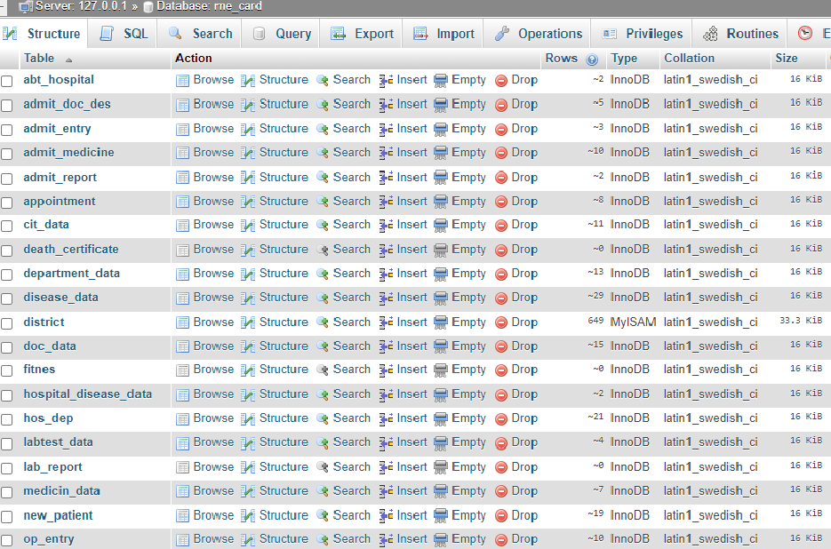
DATABASE DESIGN

Slide 13
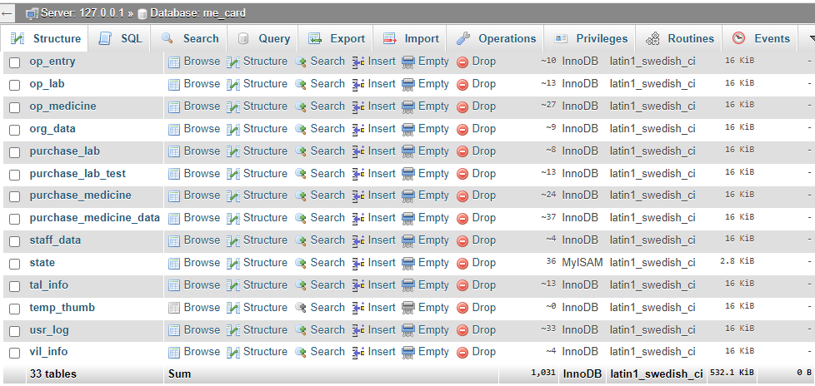

Slide 14
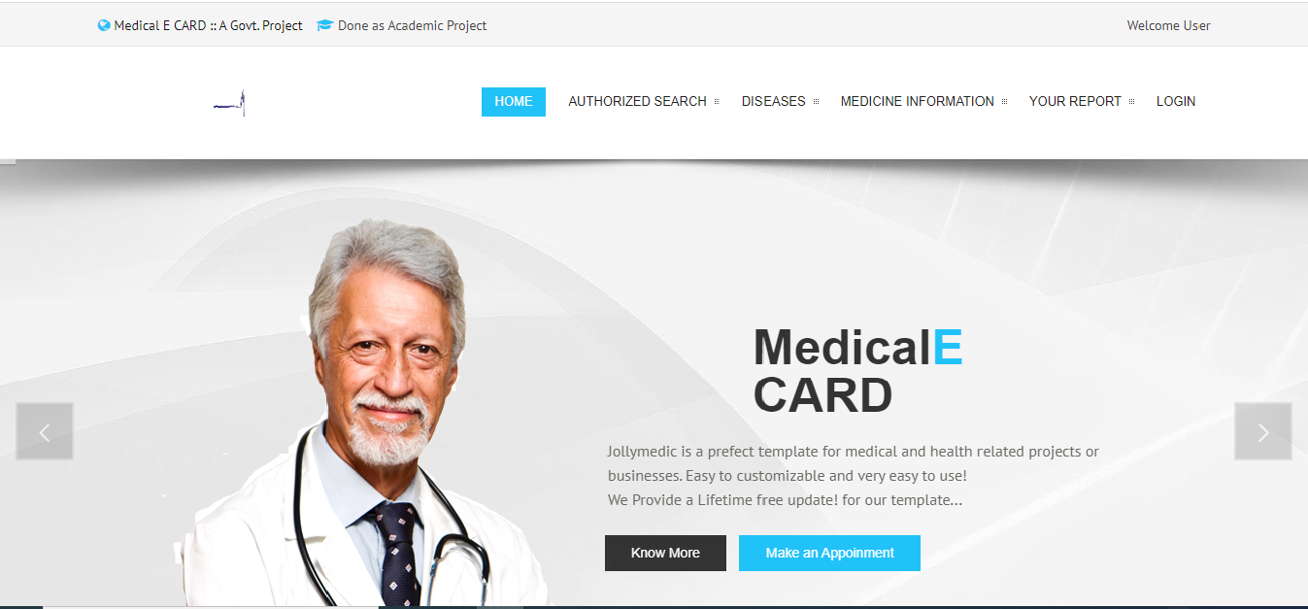

Slide 15
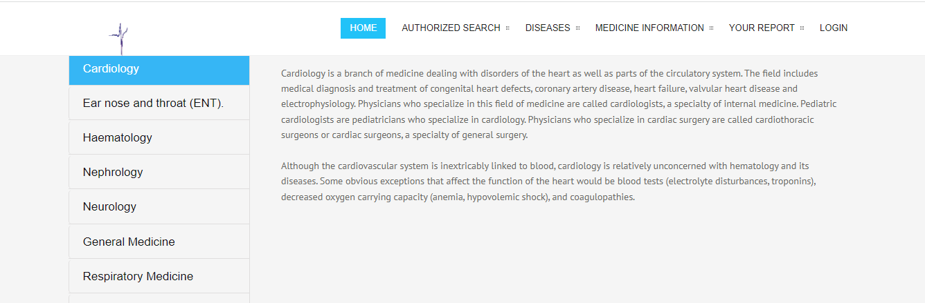

Slide 16
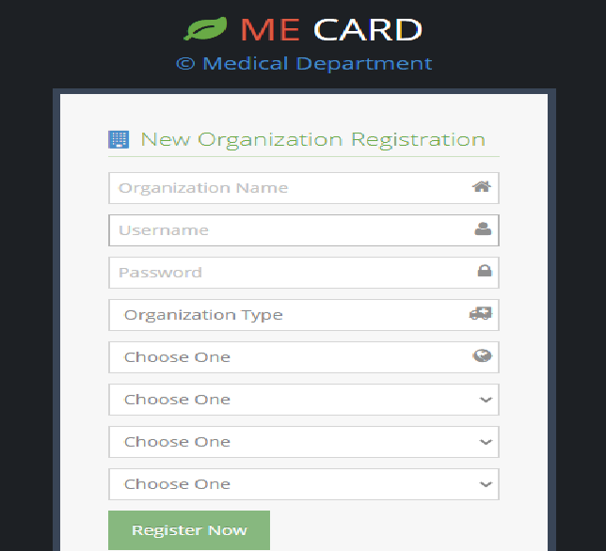

Slide 17
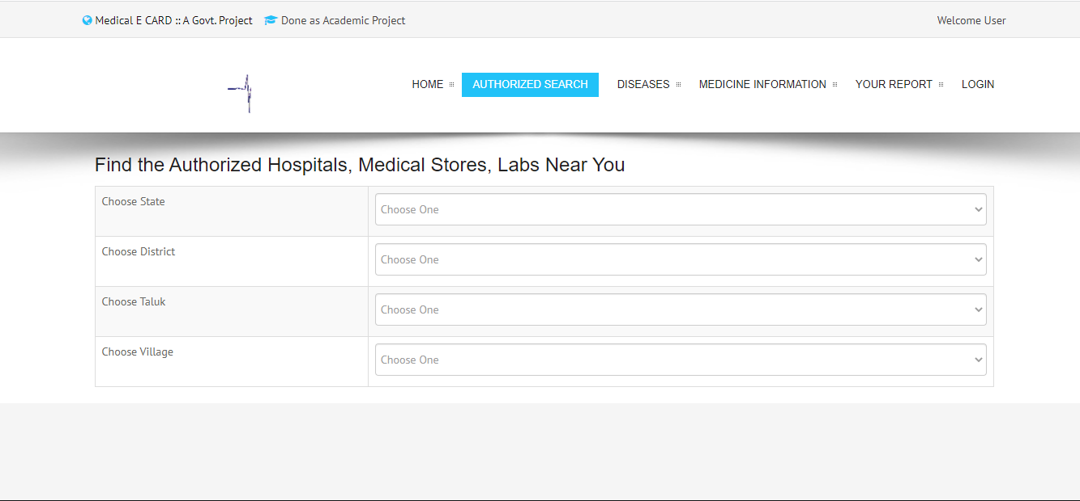

Slide 18
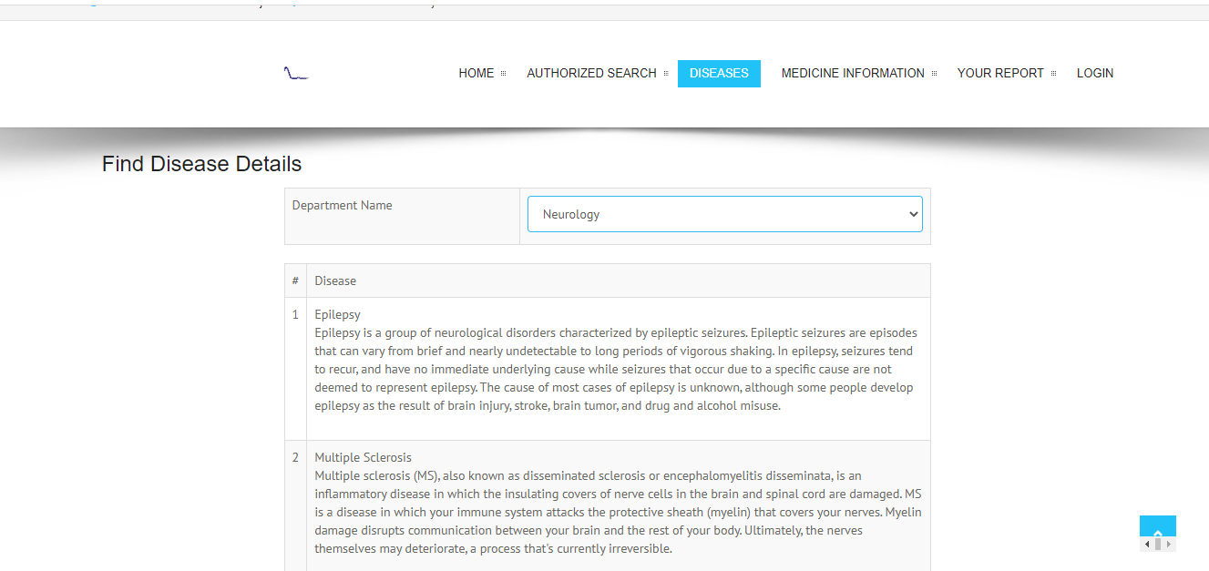

Slide 19
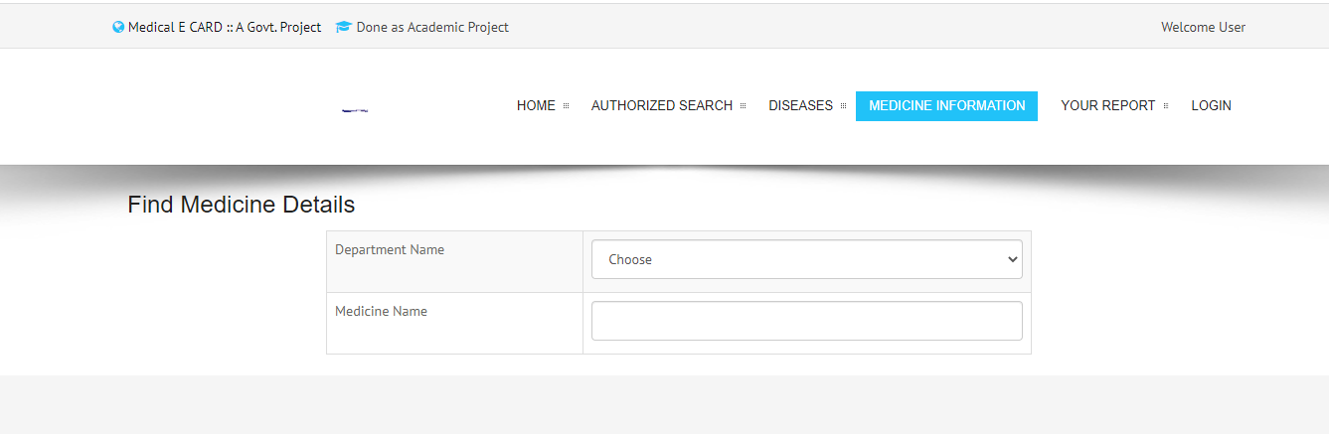

Slide 20
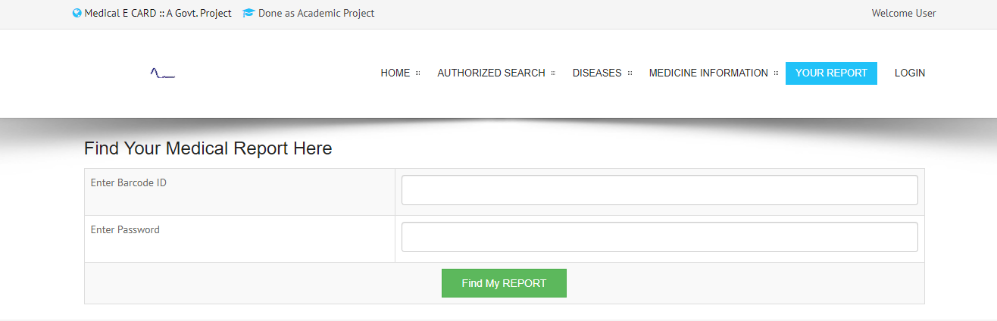

Slide 21
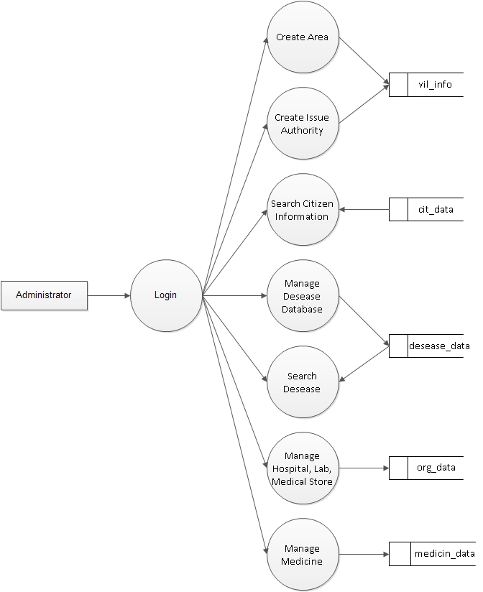
DATA FLOW DIAGRAM (LEVEL-1 ADMIN)

Slide 22
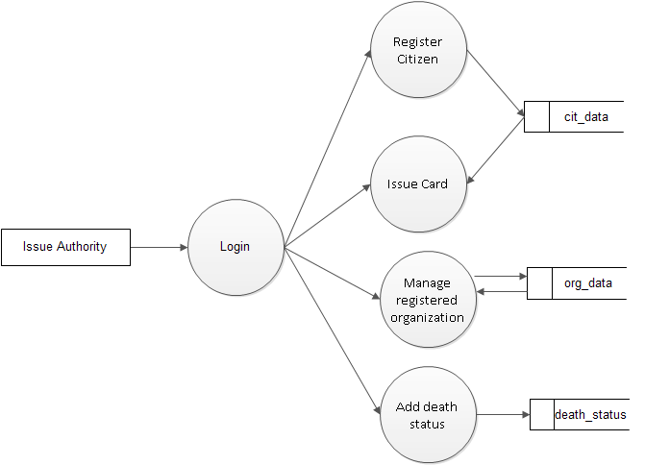
ISSUE AUTHORITY

Slide 23
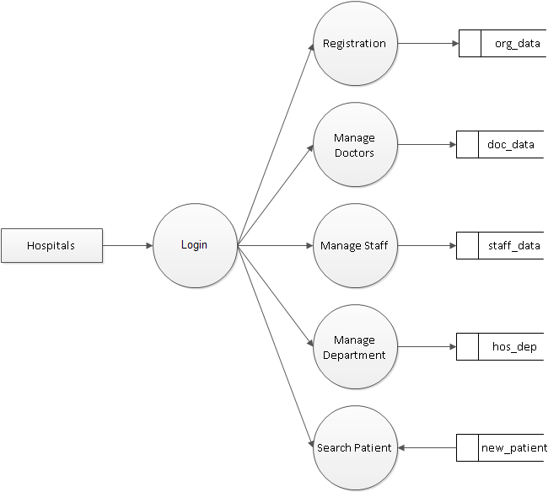
HOSPITALS

Slide 24
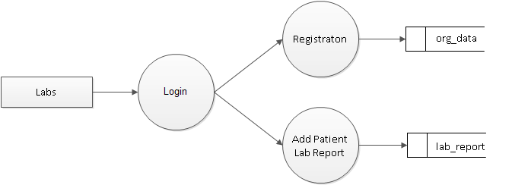
LABS

Slide 25
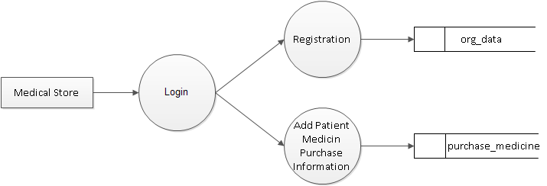
MEDICAL STORES

Slide 26
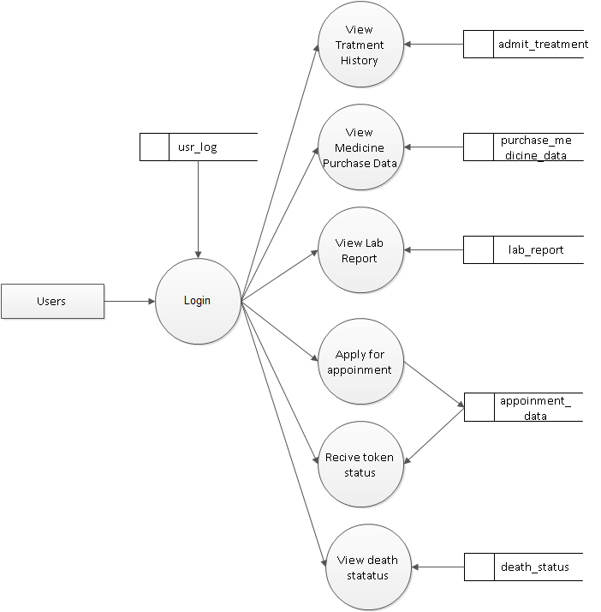
USERS

Slide 27
TIMELINE
JAN 23 –JAN 29--------------->Mod Hospitas
JAN 30 –FEB 12-------------->Mod Labs ,Medical Store
FEB 12 –FEB 26--------------->Mod Users and remaining ones any

Slide 28
REFERENCES
W3 schools php learning master class
Introducing health cards for developing countries-(https://www.diva-portal.org/smash/get/diva2:428633/FULLTEXT01.pdf)
Card studies for observation research in practice NCB
-(https://www.ncbi.nlm.nih.gov/pmc/articles/PMC3022048/)

Slide 29
THANK YOU

